Slide 1
Coursera Capstone Project
Investigating correlation between alcohol-related places and accidents involving alcohol

Slide 2
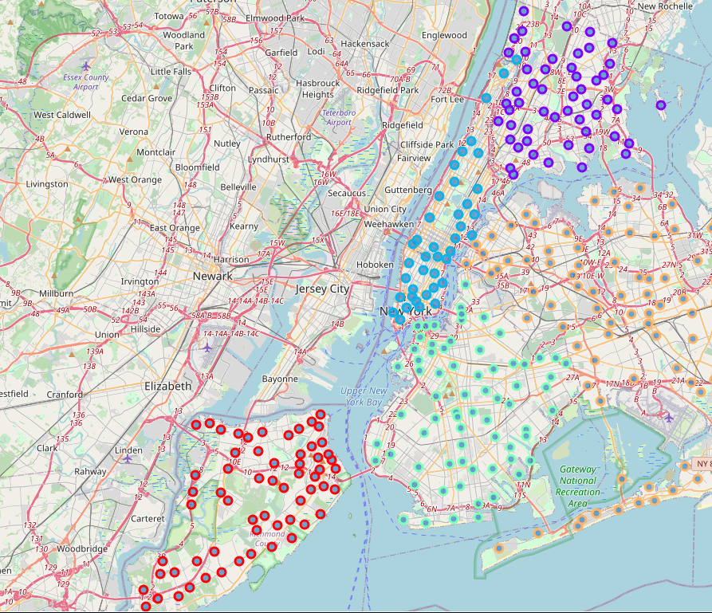
New York borough map

Slide 3
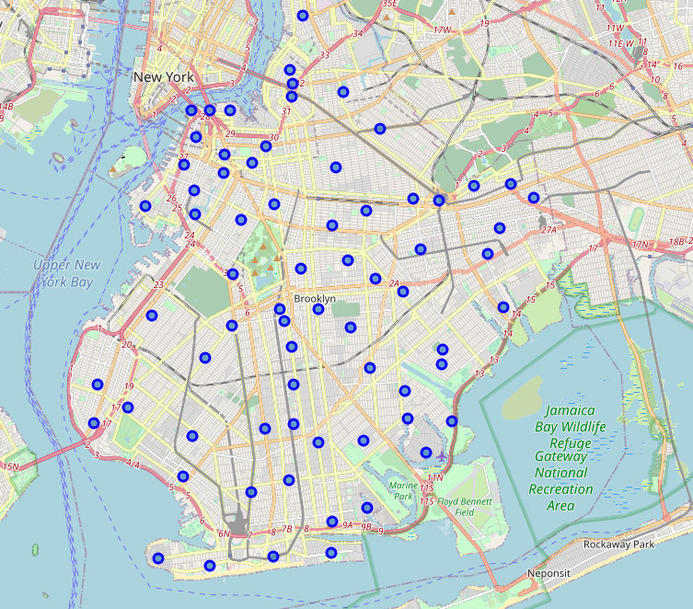
Brooklyn map

Slide 4
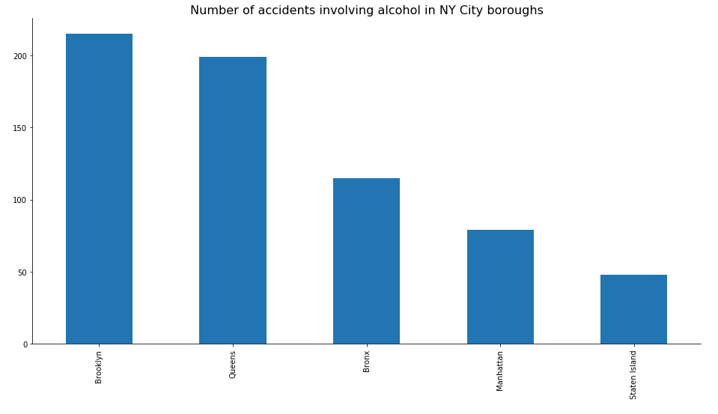
Accidents involving alcohol by borough

Slide 5
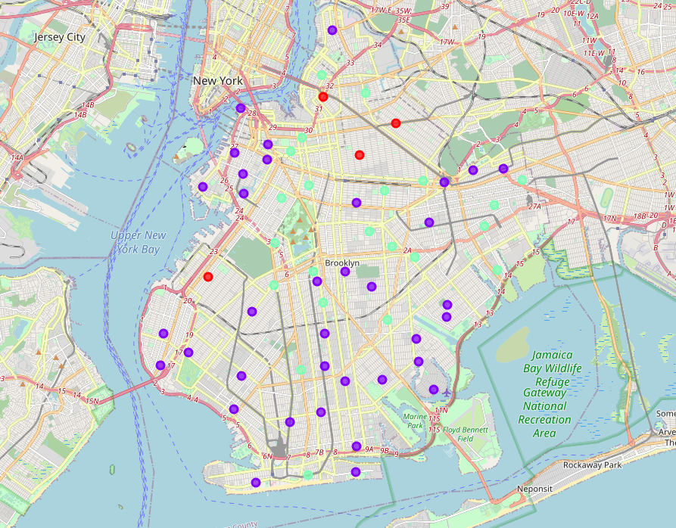
Clustering neighborhoods by numer of alcohol involved accidents

Slide 6
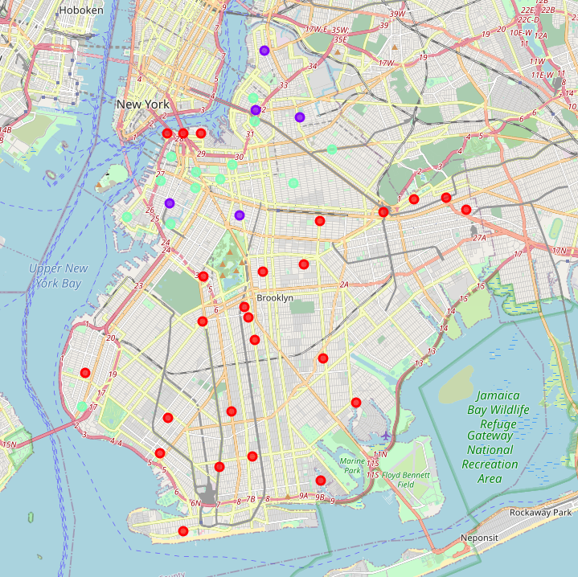
Clustering neighborhoods by number of alcohol selling/serving places

